Slide 1
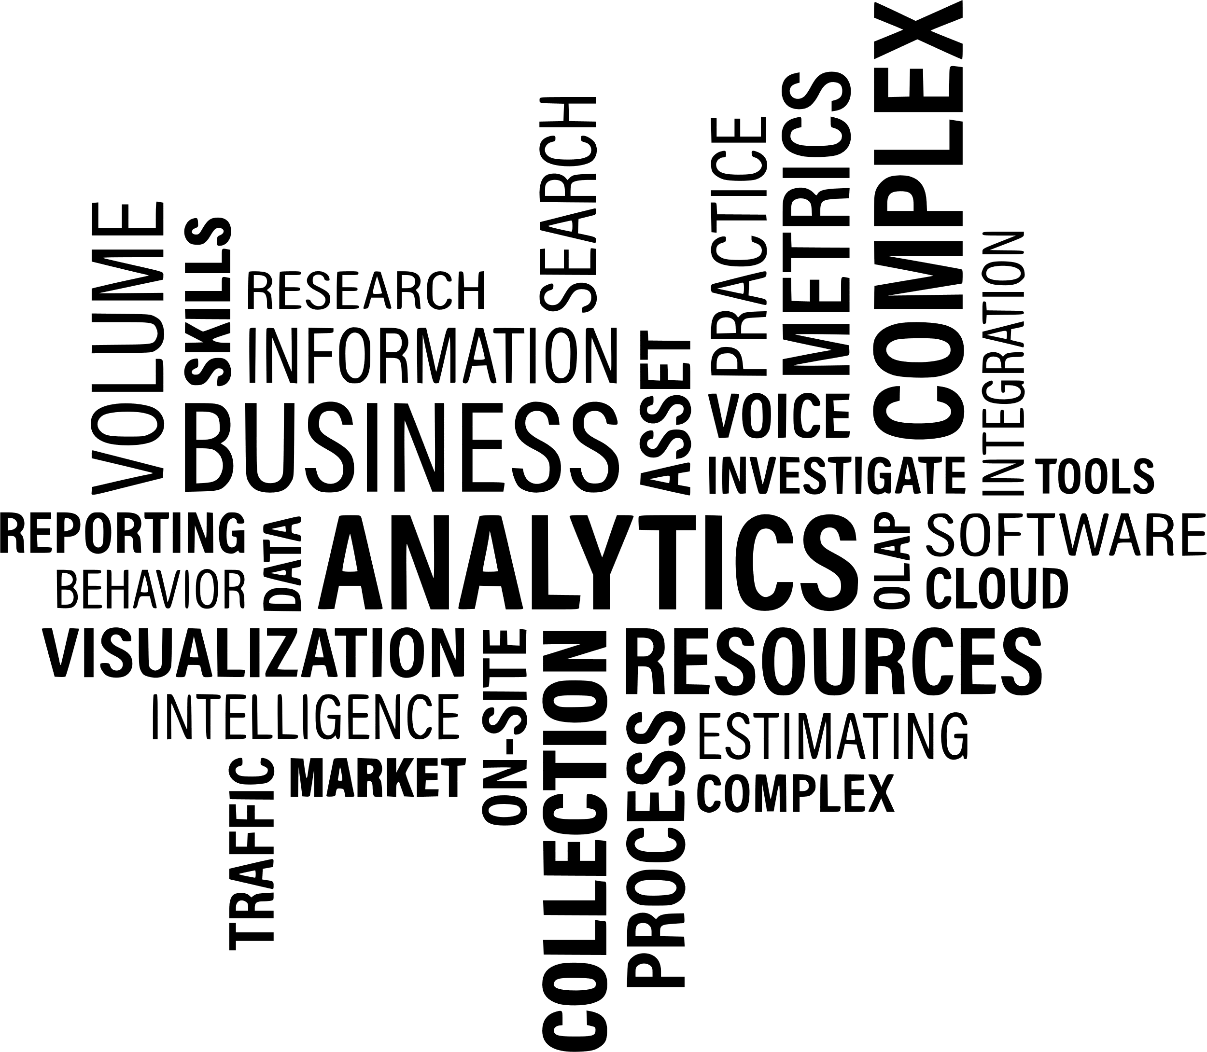

Nutri Cook
Shiva shraya
04-05-2024

Slide 2

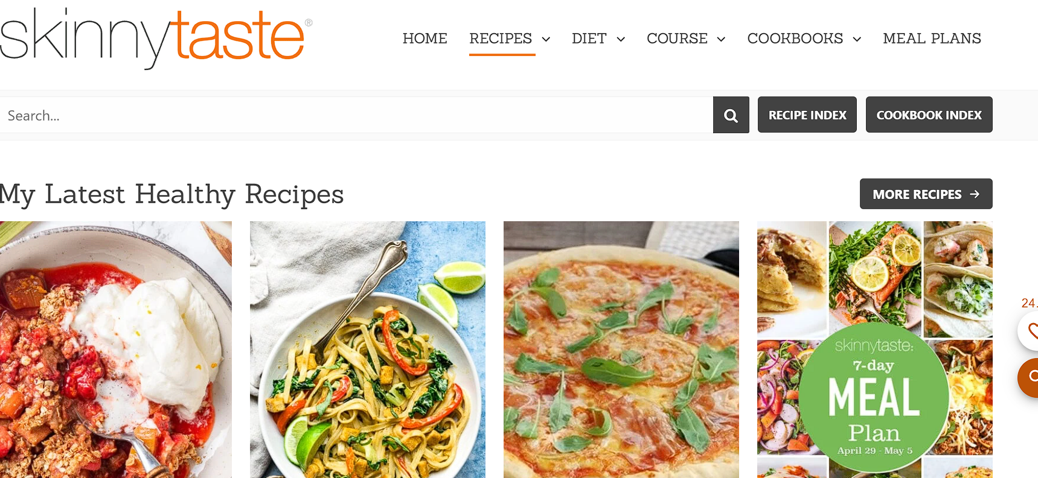
Skinny taste
WEBSITE

Slide 3








Libraries Used
Requests
BeautifulSoup
Regex(re)
Pandas
Numpy
Matplotlib
Seaborn

Slide 4
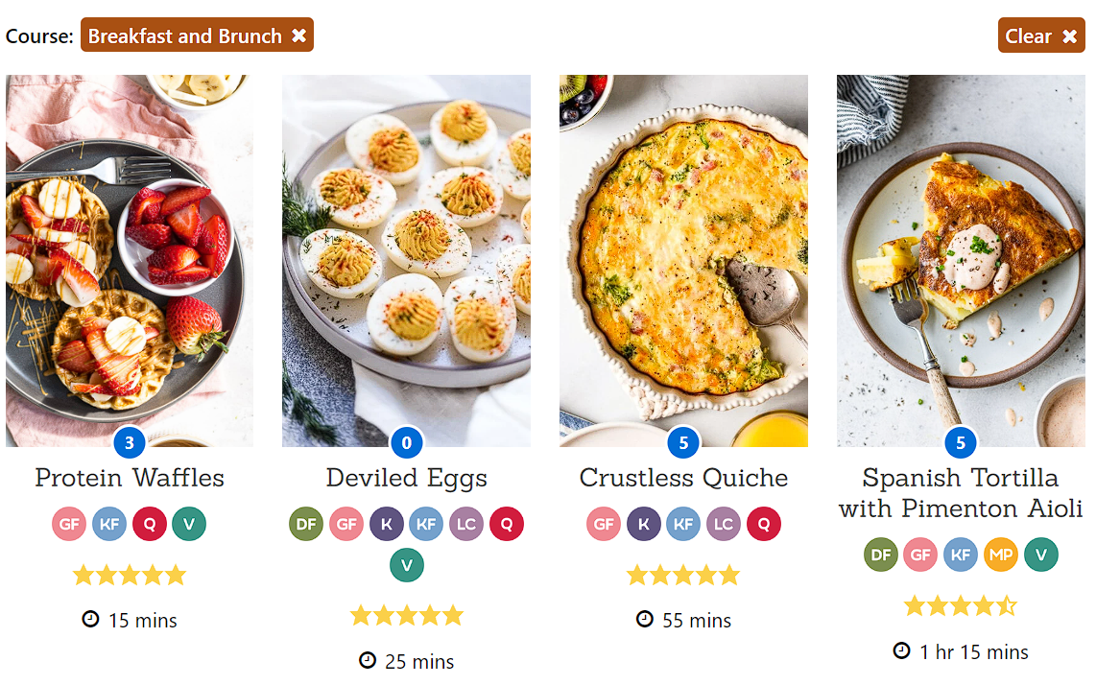
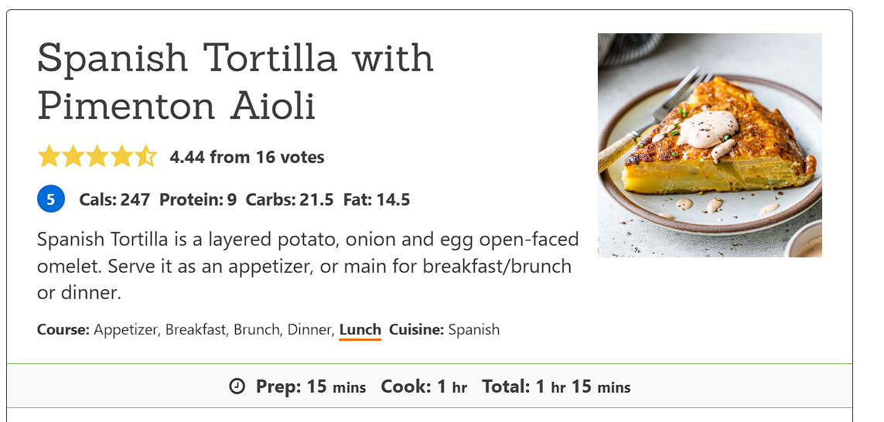
MAIN PAGE OF WEBSITE
INNER PAGE OF
THE WEBSITE

Slide 5
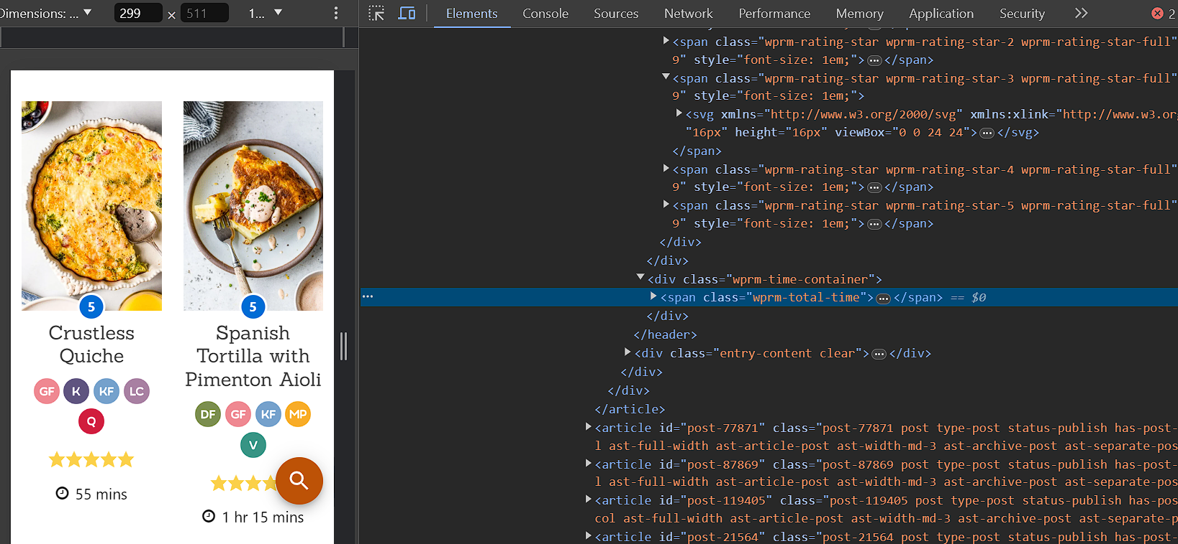
INTERFACE OF THE WEBSITE ALONG WITH THE HTML

Slide 6
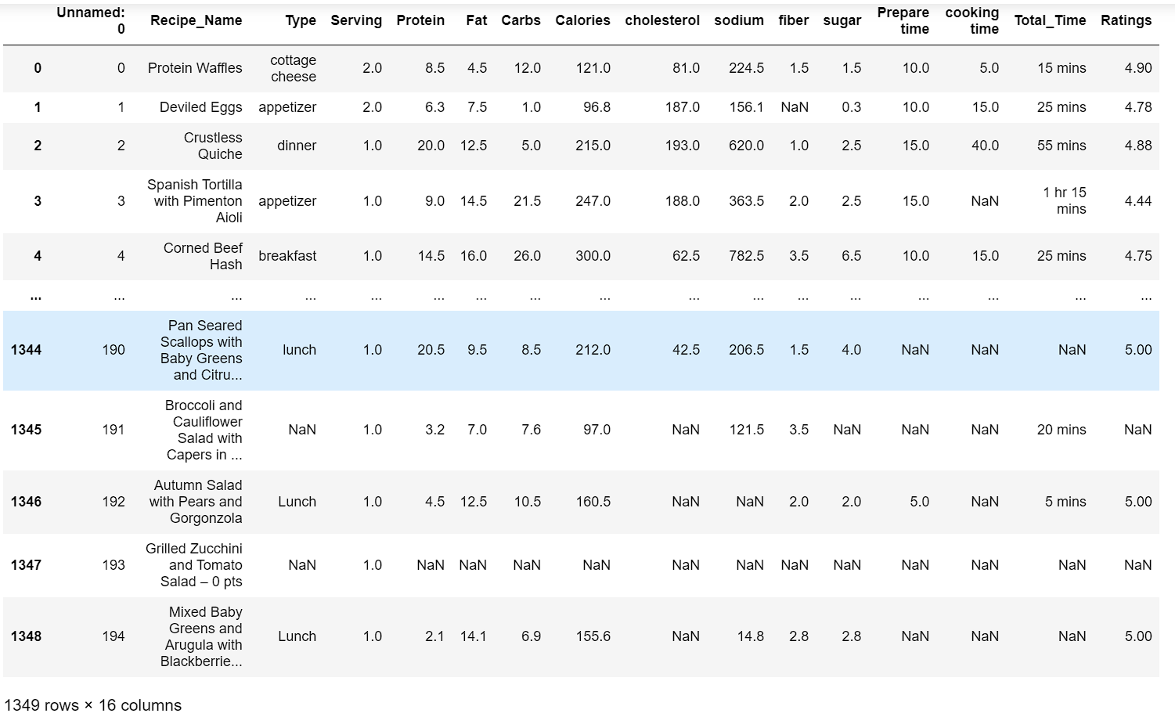
RAW DATA

Slide 7
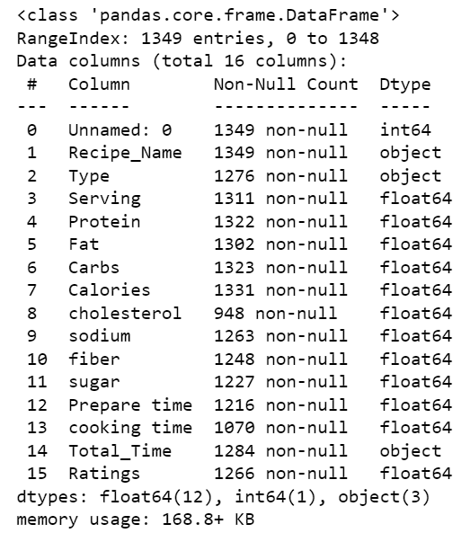
Raw Data Info( )

Slide 8
Process of Data Cleaning
TWO: Data type conversion: This step involves converting data from one data type to another to ensure that it is in the correct format for analysis.
THREE: Removing irrelevant data: This step involves removing any data that is not relevant to the analysis By using Regex and split.
FOUR: Removing irrelevant columns: This step involves removing any columns that are not needed for the analysis or research that is being conducted.
FIVE: Saving the cleaned data: This step involves saving the cleaned data in a format that is easy to access and analyze.
ONE: Check for missing values: This step involves checking for missing values in the data set and filling them in with appropriate values or removing them if necessary.

Slide 9
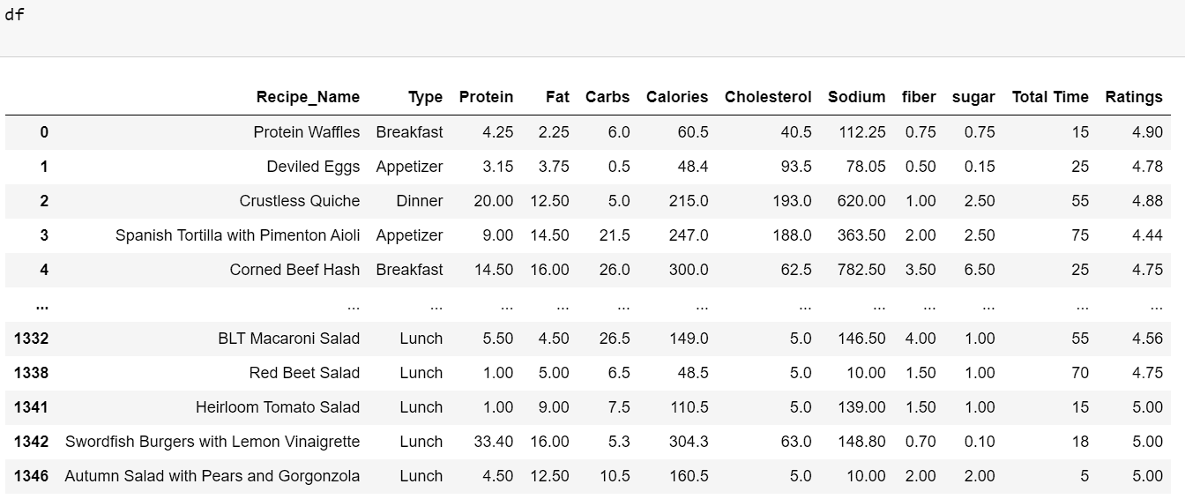
CLEANED DATA

Slide 10
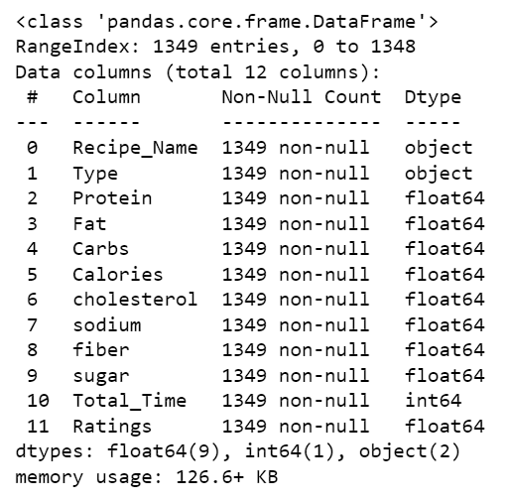
Cleaned Data info( )

Slide 11

Data Visualization

Slide 12
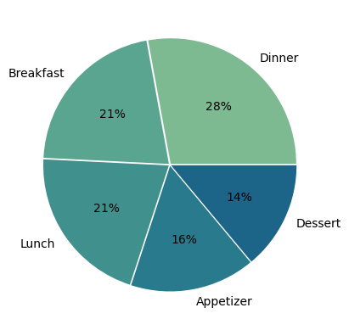
Insight 1:
Finding value count for type of recipes – using pie chart

Slide 13
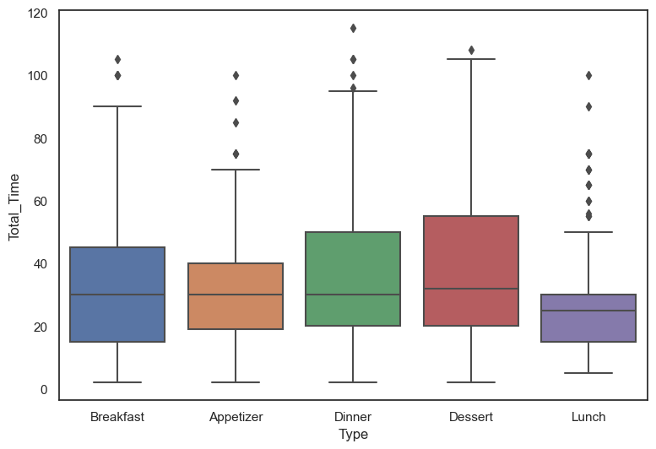
Insight 2:
Total time vary across different recipe types – using boxplots

Slide 14
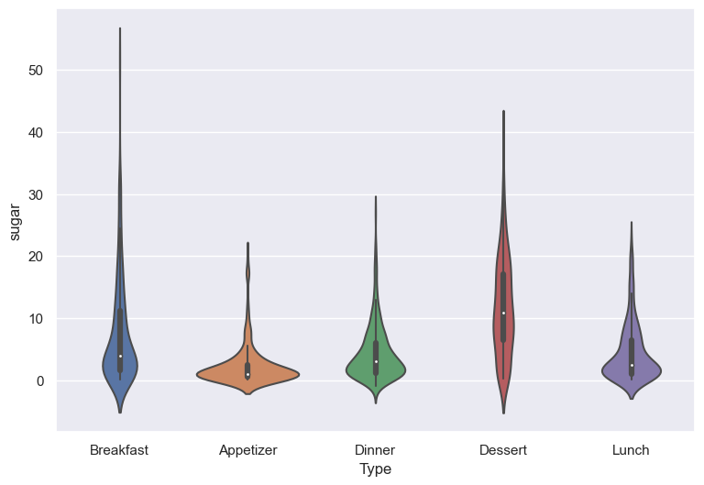
Insight 3:
Distribution of Type of Recipes time among Sugar - using Violin Plot

Slide 15
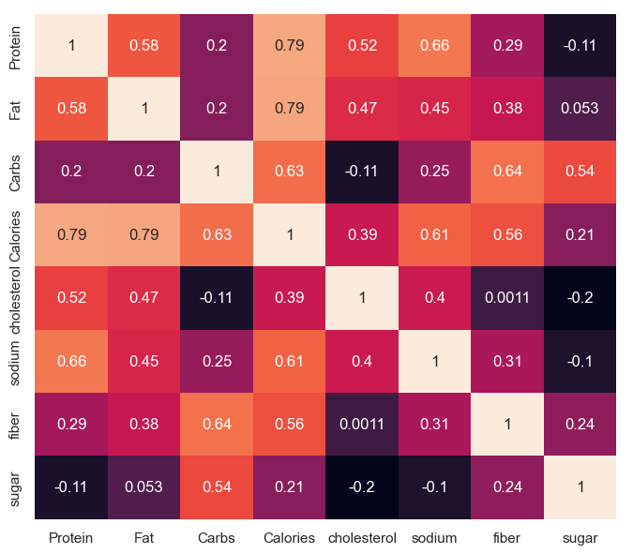
Insight 4:
Finding relation between these columns – using Heatmap (correlation)

Slide 16
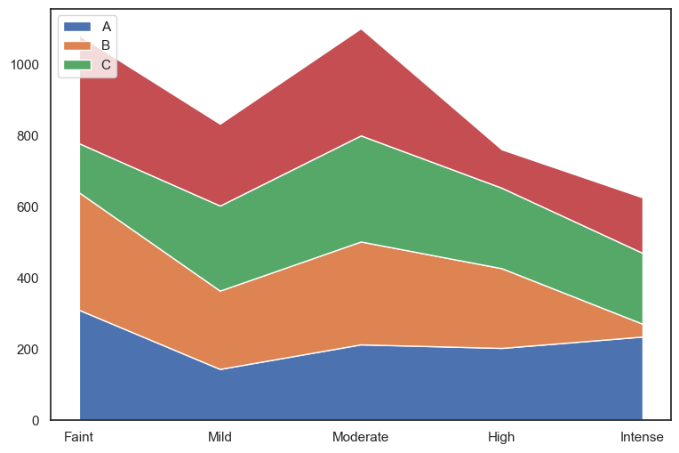
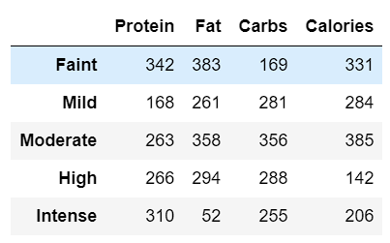
Insight 5:
Finding range values for These columns – using Line chart

Slide 17
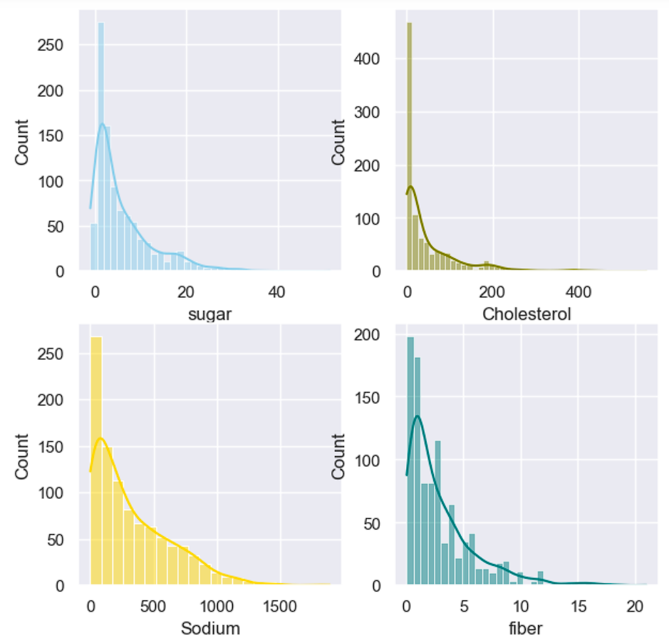
Insight 6:
Count for these columns – using hist plot

Slide 18
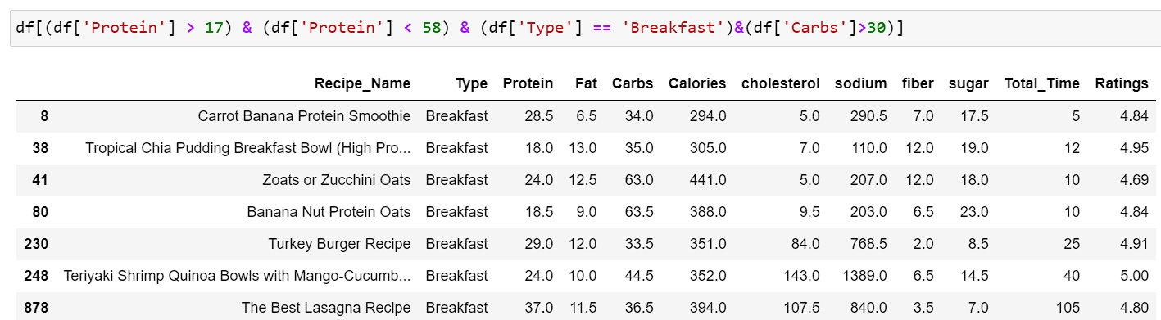
CONCLUSION 1

Slide 19
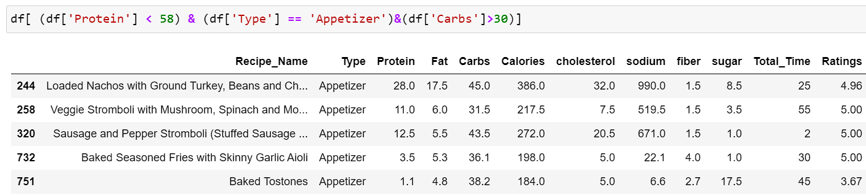
CONCLUSION 2

Slide 20
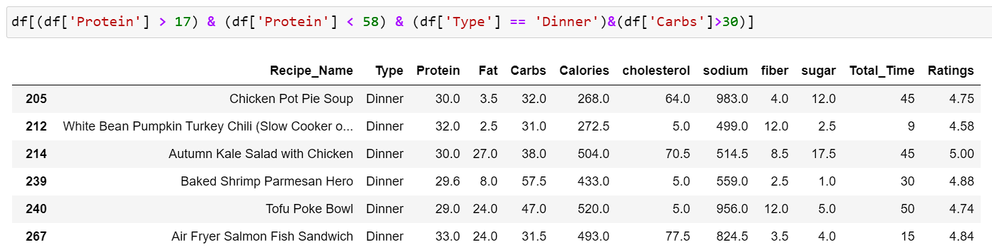
CONCLUSION 3

Slide 21
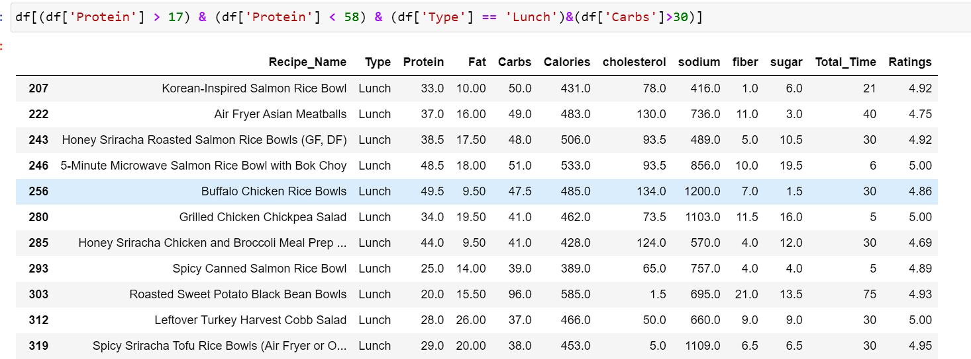
CONCLUSION 4

Slide 22


